Slide 1
Natural Disaster Data Analysis
Presented By
Neha Navgale and Naga Srividya Varanasi
University of Missouri-Kansas City
Missouri, USA

Slide 2
Motivation
Researchers are debating whether natural disasters can teach us something about human behavior.
Insight could be used to protect us in the future.
Unfortunately, we can’t prevent natural disasters or predict them with 100 percent certainty
But we can find out whether we can make our societies more resilient to natural disasters, so that people can get through them. We can do that by looking at the ways in which our societies have handled natural disasters in the past.

Slide 3
Objective
Understanding of the disaster phenomenon, its impacts on humanity and economy.
Research and analysis of all natural disasters happened all over the world.
Generate insights and visualizations (analysis charts):
Number of reported disasters by type
Human impacts from disasters
Economic costs
Death rates

Slide 4
Block diagram of the Project
Data from ‘NASA’ and ‘World in Data’
Processing and filtering
Abstraction and pattern recognition
Comparison
Knowledge visualization

Slide 5
Tools languages and platform
AWS cloud
Python
PyCharm
Google Map API

Slide 6
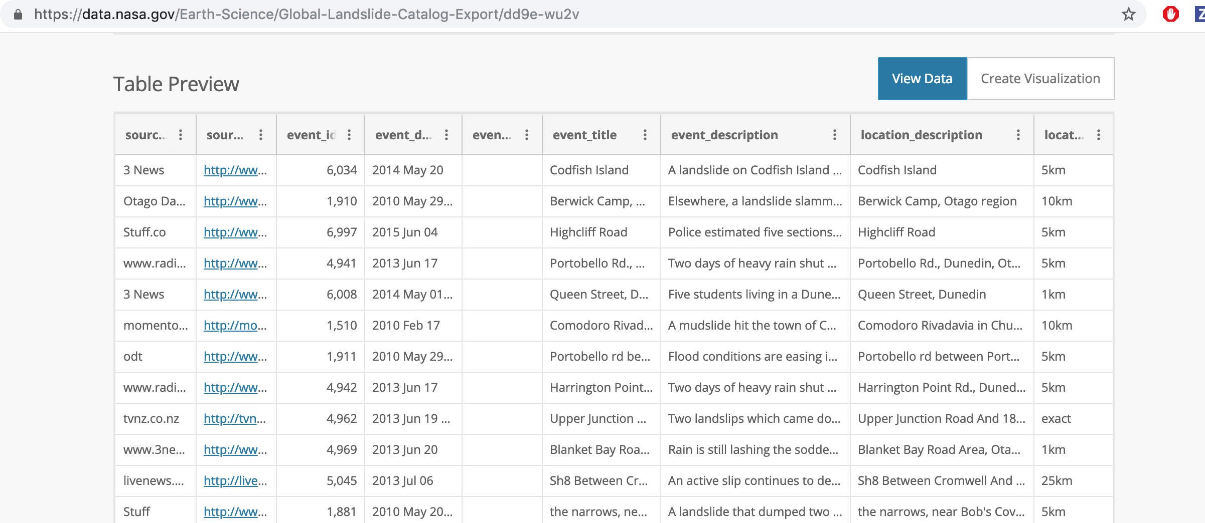
Evaluation/Implementation/Development Plan
Type/Source of Data
NASA (LandSlide):

Slide 7
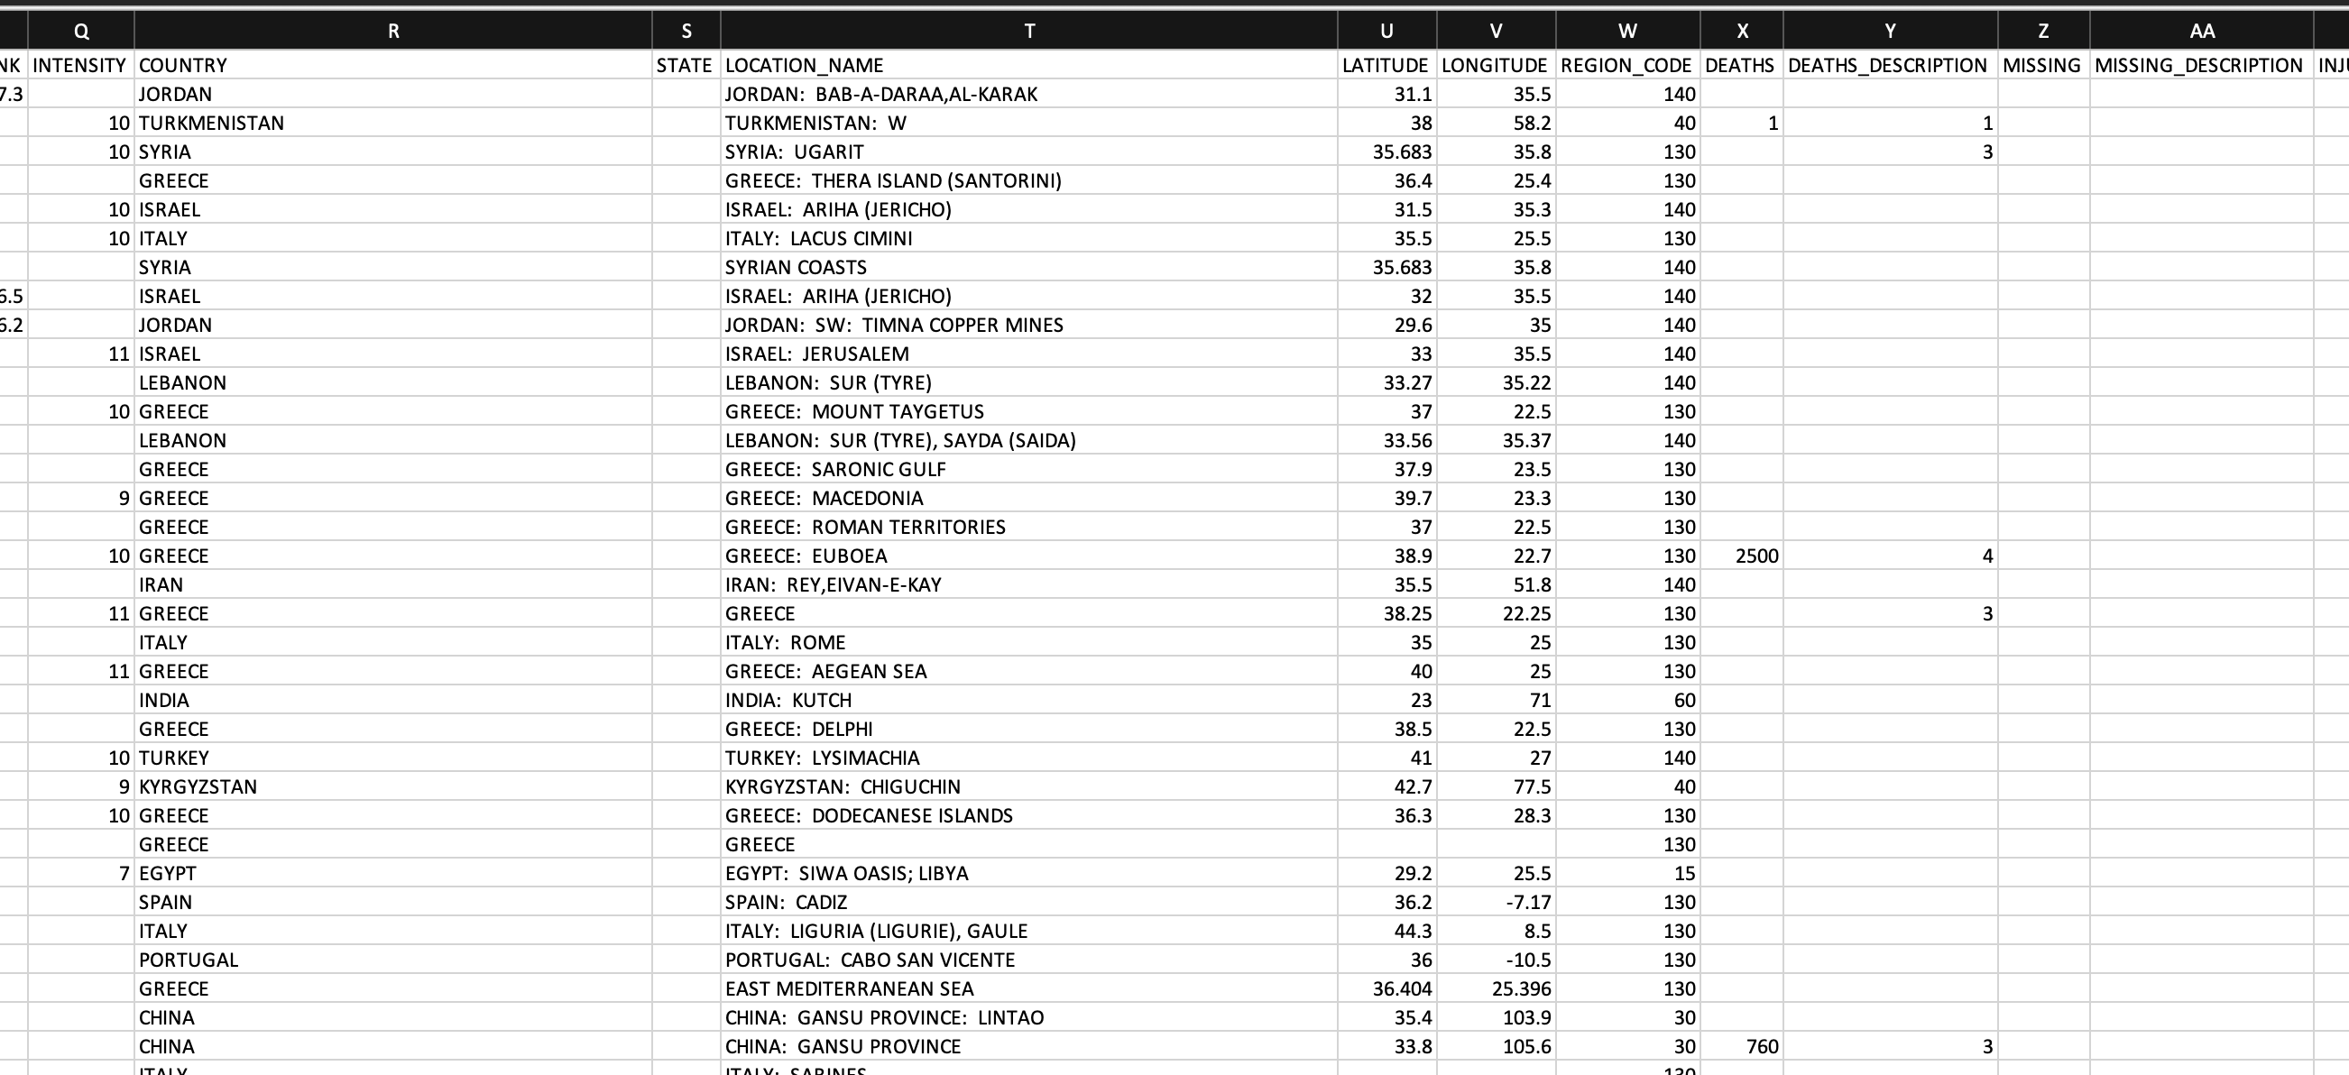
Evaluation/Implementation/Development Plan
Type/Source of Data
World in Data:

Slide 8
Evaluation/Implementation/Development Plan
Type of Analysis
Visualization and comparison of occurrence of disaster in different parts of the world based on type, year, economic cost, frequency, human suffering.
Performance parameters
Response Time

Slide 9
Expected project outcome (Conjecture, Hypothesis)
Empirical View of data related to natural disasters.
Graphical representation and comparison of disasters happened in past.
Locating disasters on Google map.

Slide 10
Individual learning outcome
Big data Analytics
Storing and deployment on Cloud
Google map API

